Slide 1


IOT Sensors
Information about iot sensors

Slide 2
What is sensors ?
A sensor is a device or component that detects changes in its environment and converts them into electrical signals or data that can be interpreted by a system.
Sensors play a critical role in enabling devices to interact with and respond to their surroundings.

Slide 3
What is use of sensor?
Sensors are used to monitor, measure, and detect various physical, chemical, or biological phenomena and convert them into actionable data for various applications.
Sensors gather real-time data from the environment or systems, which is crucial for monitoring and decision-making.
Sensors enable automated systems to take appropriate actions based on the data collected.

Slide 4
Key Features of sensors
1. Sensitivity
2. Accuracy
3. Range
4. Resolution
5. Response Time

Slide 5
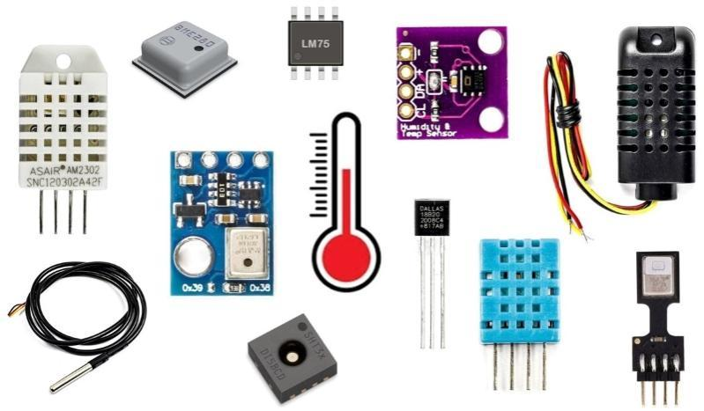
Types of sensors
• Environmental Sensors
1. Temperature Sensors: Measures ambient temperature.
Source :- https://images.app.goo.gl/7nmFrSKXdrsJ5mS18

Slide 6
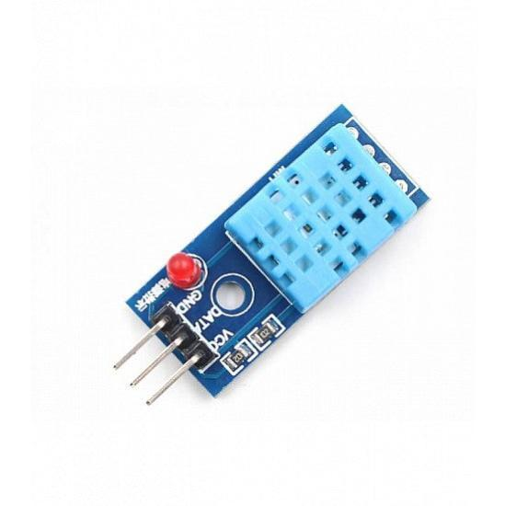
2. Humidity Sensor: Detects moisture levels in the air.
Sources :- https://images.app.goo.gl/c4Q965M93CHFoLkcA

Slide 7
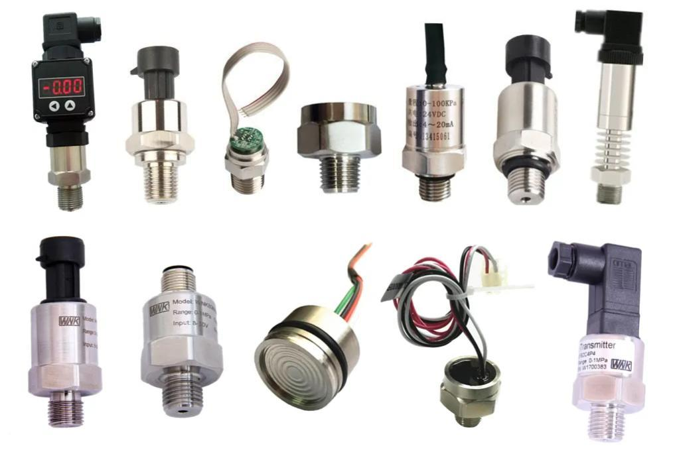
3. Pressure Sensor: Monitors atmospheric or liquid pressure.
Sources :- https://images.app.goo.gl/jjEXz3CVbLVkgvYDA

Slide 8
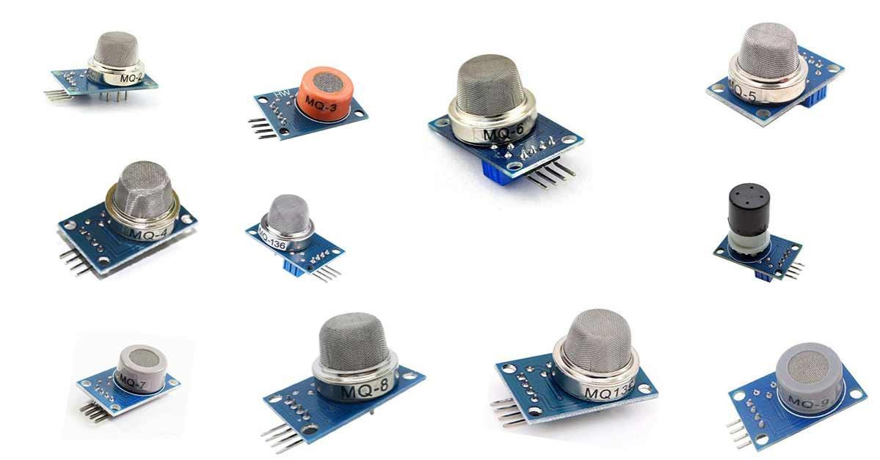
4. Gas Sensor: Detects harmful gases (e.g., CO2, methane, or LPG).
Source :- https://images.app.goo.gl/u7kTLBnPyddUmhZi7

Slide 9
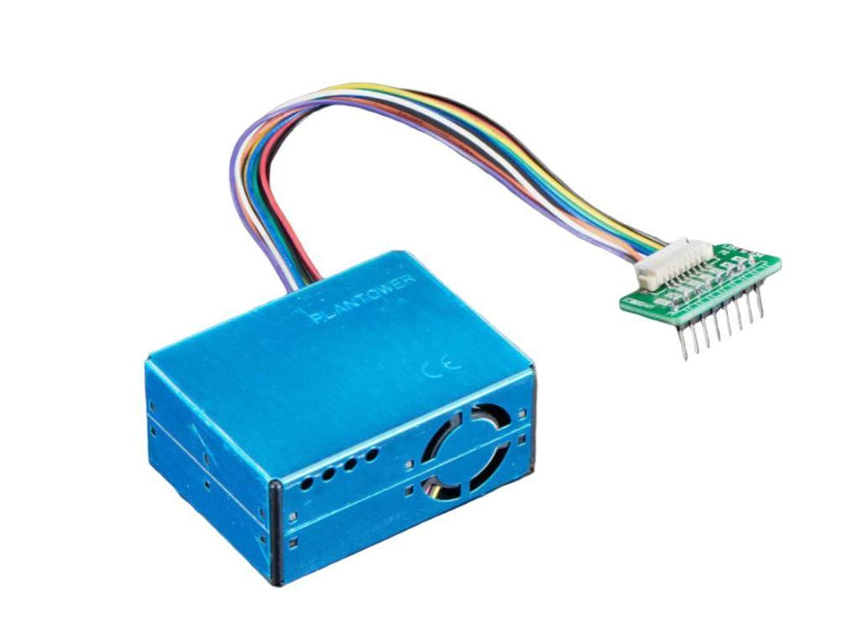
5. Air Quality Sensor: Measures pollutants like PM2.5.
Source :-https://images.app.goo.gl/HcruXBherysQZaRy5

Slide 10
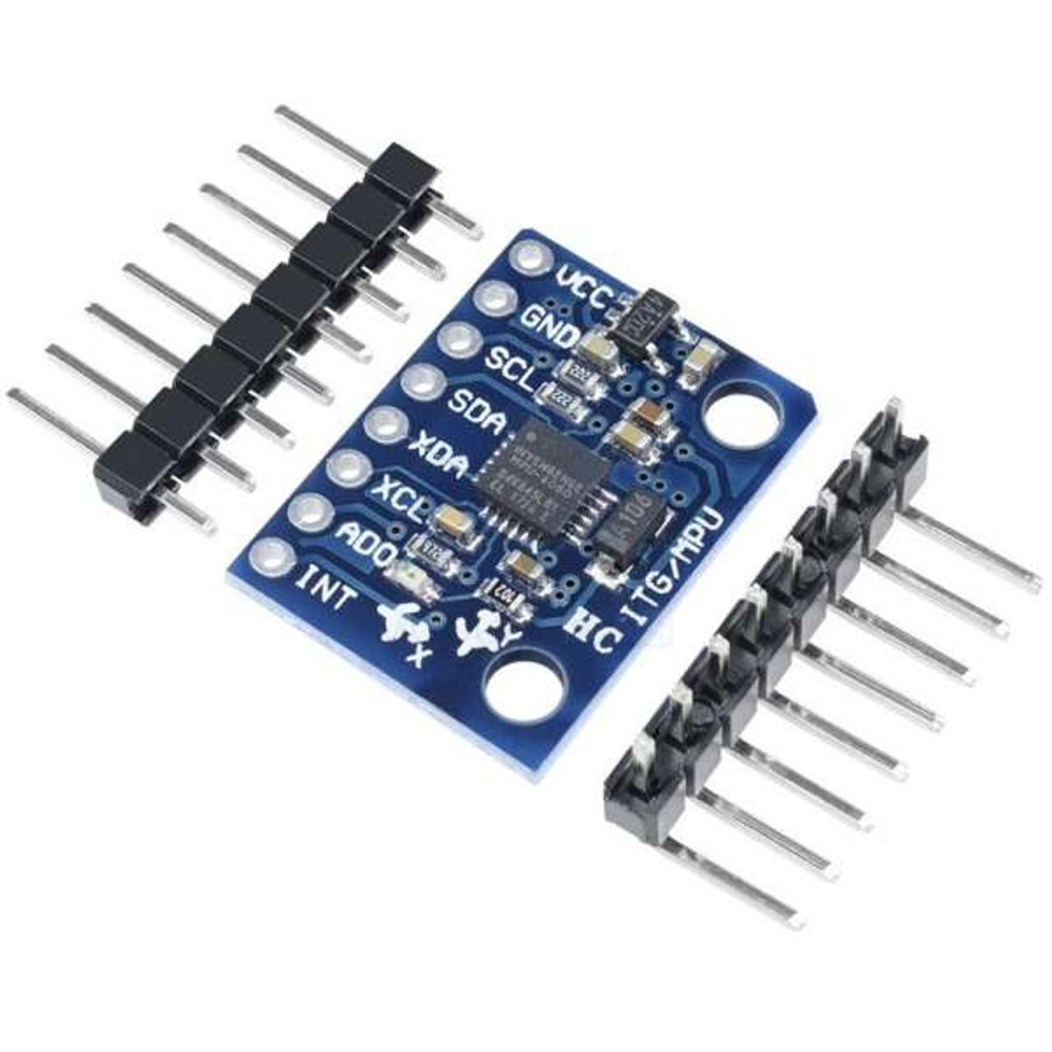
Motion and Proximity Sensors
1. Accelerometer: Detects acceleration and movement.
Sources :- https://images.app.goo.gl/UK2JV1wPuUGDmUeZA

Slide 11
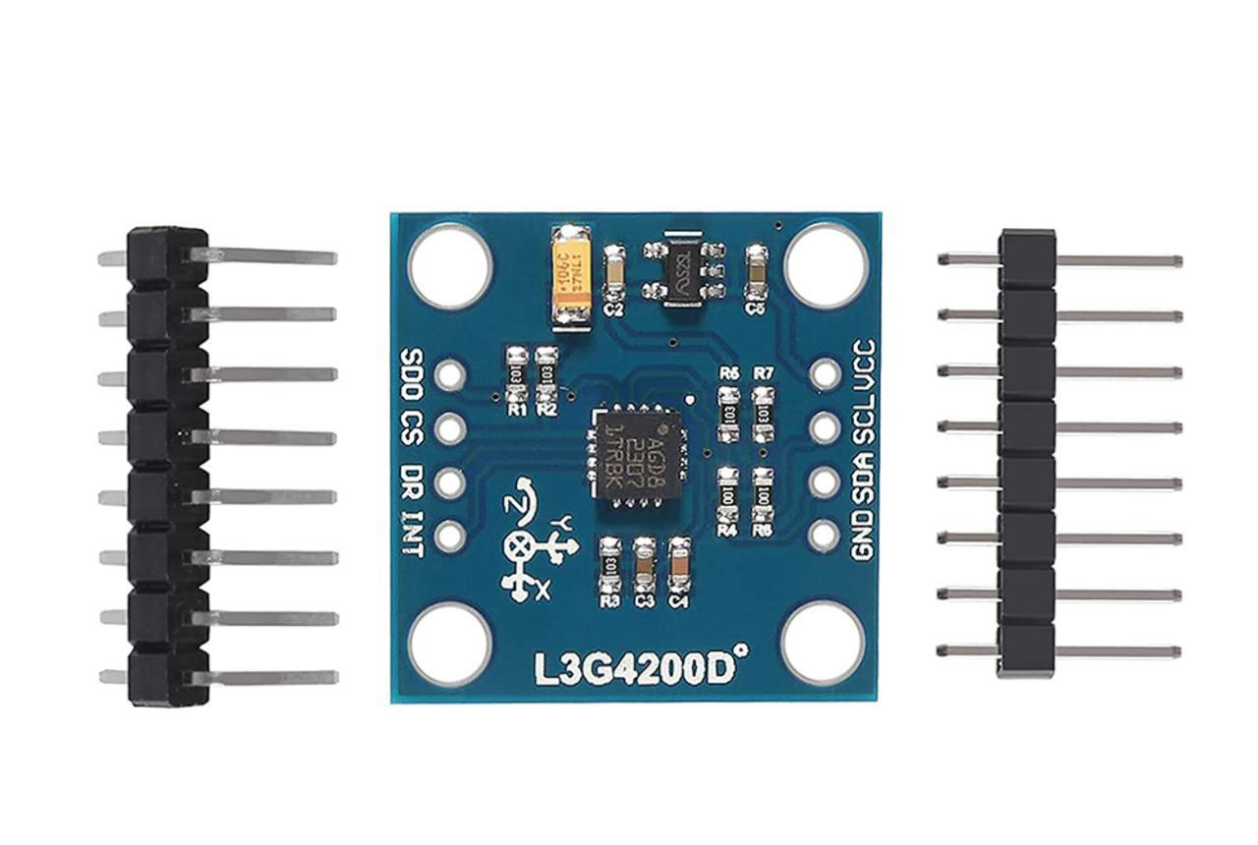
2. Gyroscope: Measures angular velocity.
Source :- https://images.app.goo.gl/XPXSS9BMvMUg7tuo9

Slide 12
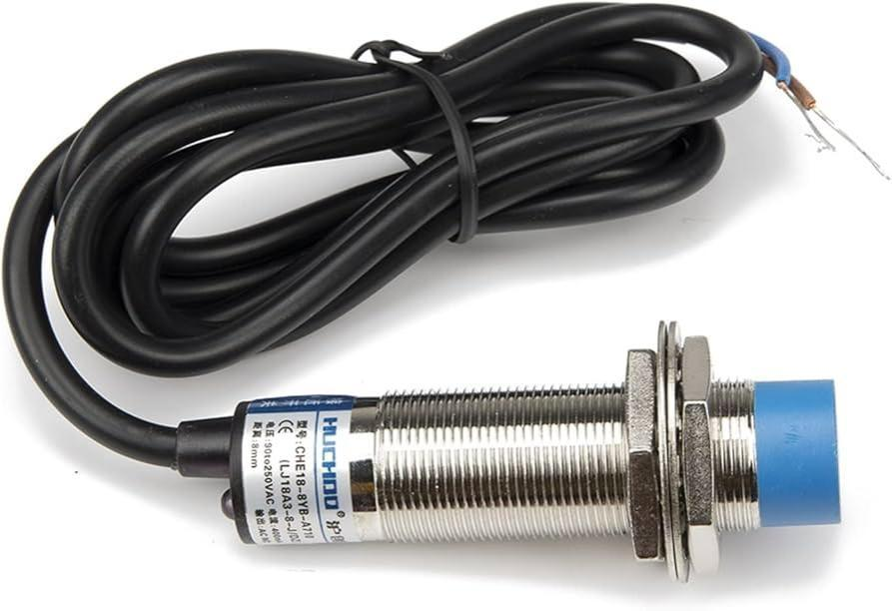
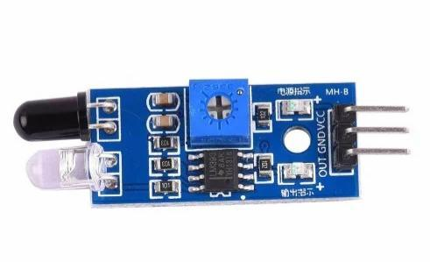
3. Proximity Sensor: Detects nearby objects without contact.
Source :- https://images.app.goo.gl/pL6A2mXndhnHkt2E8
Source :- https://images.app.goo.gl/LBJzXN1kdh3UWMsf8

Slide 13
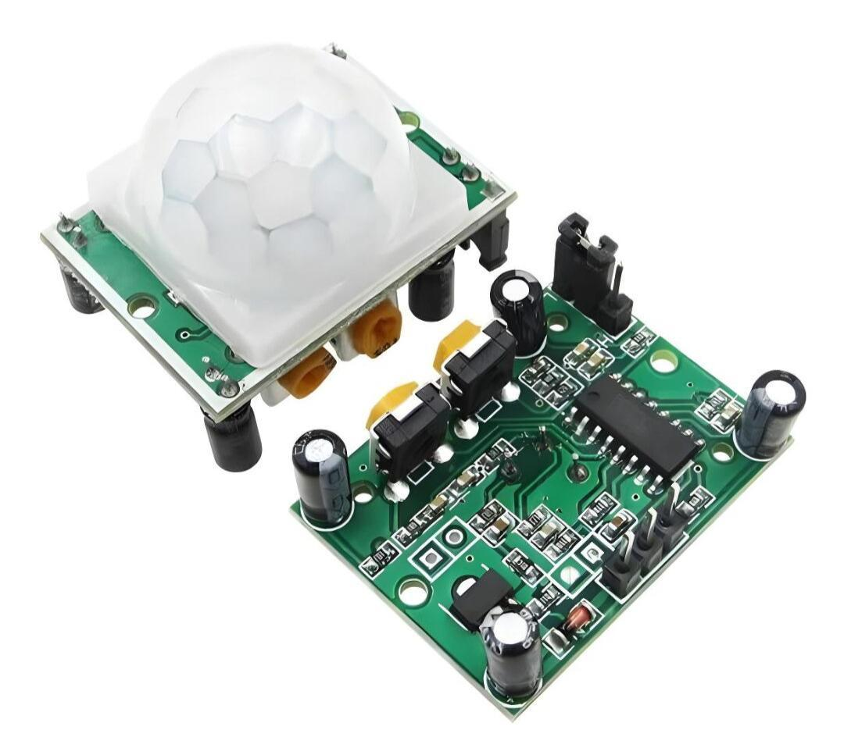
4. PIR Sensor: Detects motion through infrared radiation.
Source :- https://images.app.goo.gl/xe1mTTSfi8LEgWtz8

Slide 14
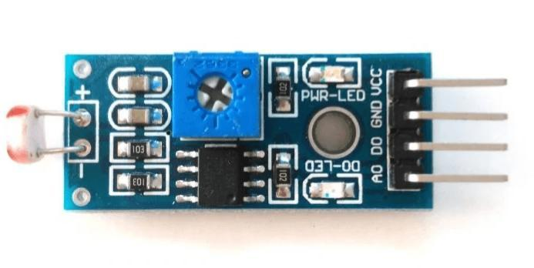
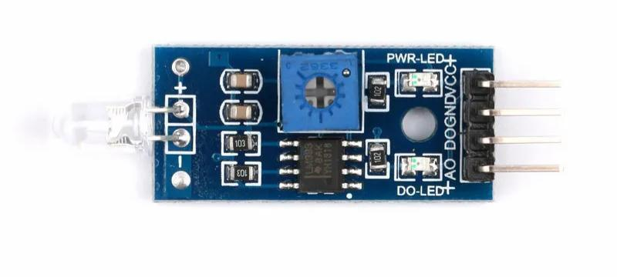
Light and Imaging Sensors
1. Light Sensor: Measures light intensity (e.g., LDR, photodiodes).
Source :- https://images.app.goo.gl/XMt2Bc2qikstE6Mm9
Source:- https://images.app.goo.gl/KEgzQZzPfn5bNVu3A

Slide 15
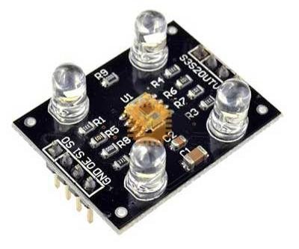
2. Color Sensor: Detects specific colors or wavelengths of light.
Source :- https://images.app.goo.gl/qZMKuH3Ei4WSZH356

Slide 16
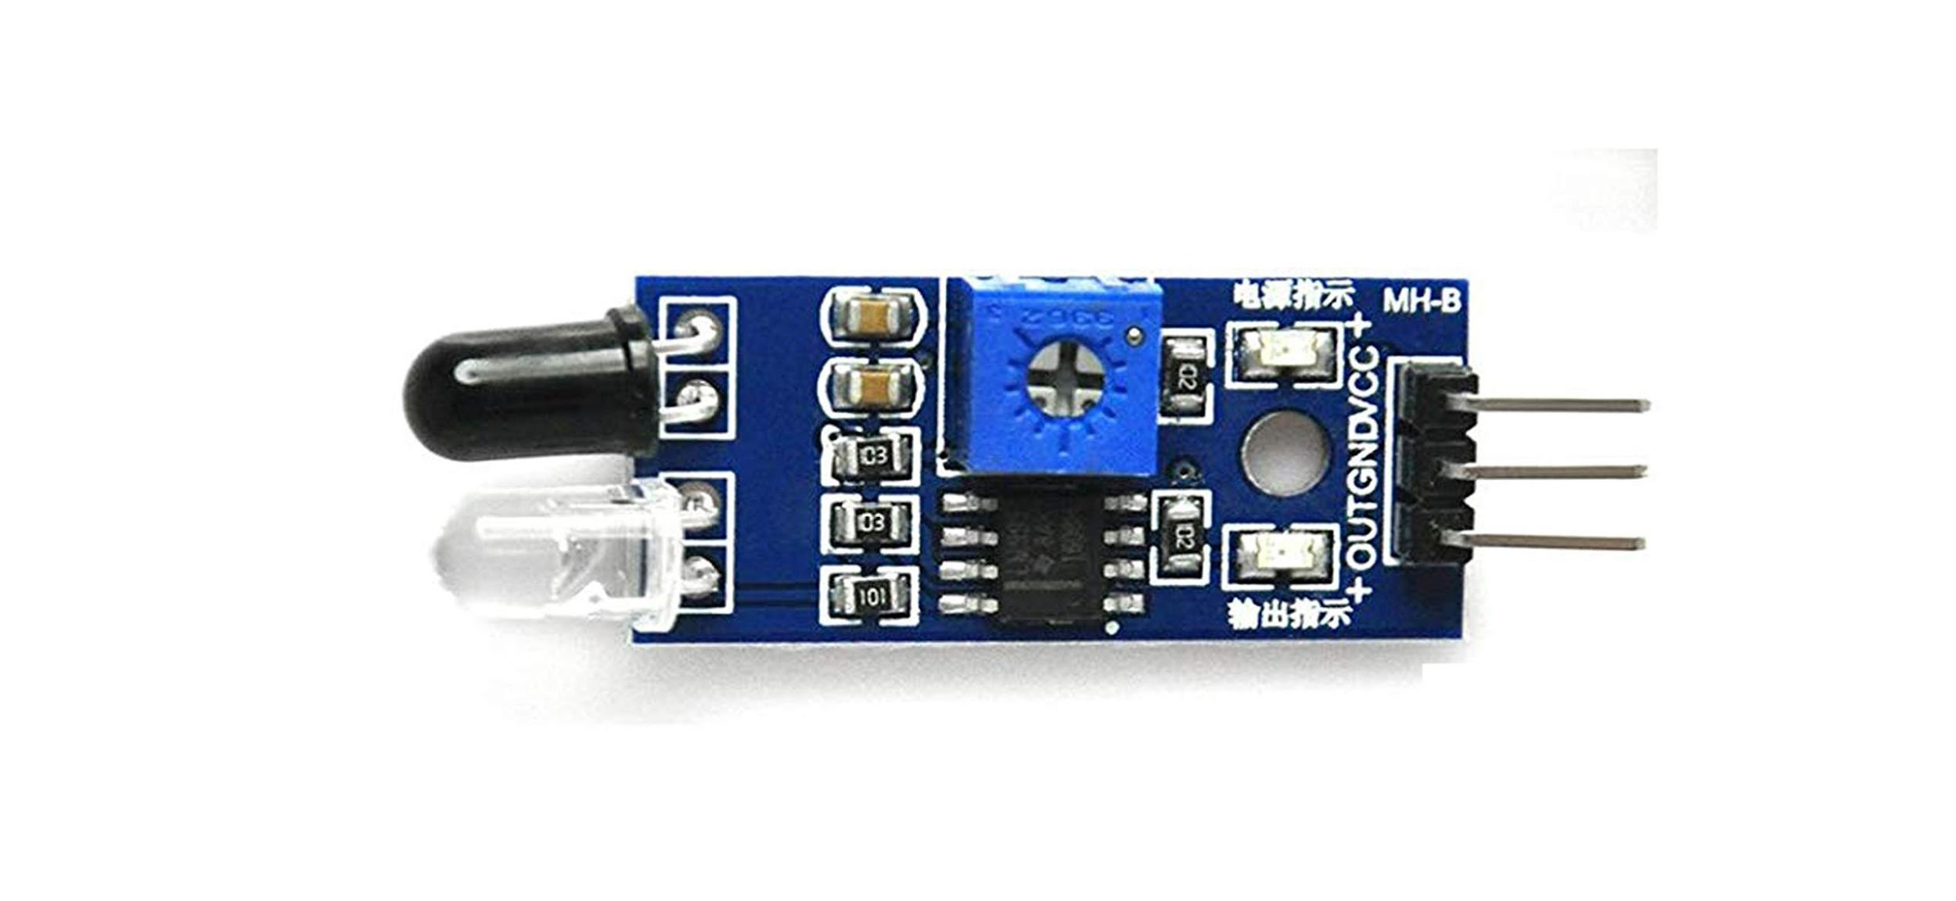
3. Infrared (IR) Sensor: Used in remote control and proximity detection.
Source :- https://images.app.goo.gl/EexZ9UhxiBKJeLsw9

Slide 17
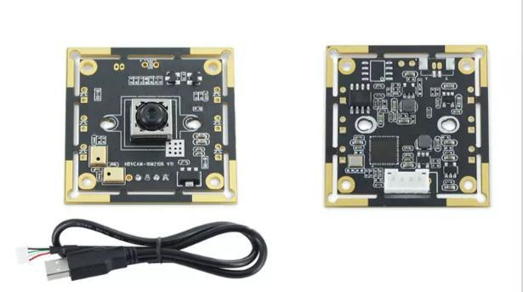
4. Camera Sensors: Captures images or video for visual processing.
Source :- https://images.app.goo.gl/6DJPR1VRXUdgmBhg9

Slide 18
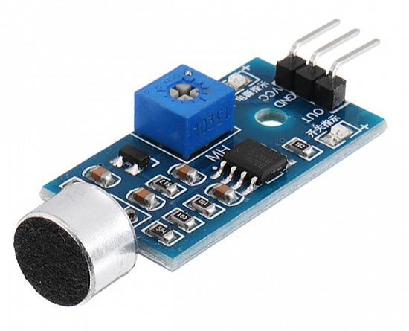
Sound and Vibration Sensors
1. Microphone: Detects sound or voice.
Source :- https://images.app.goo.gl/kQnKDSgv5LSijMaV7

Slide 19
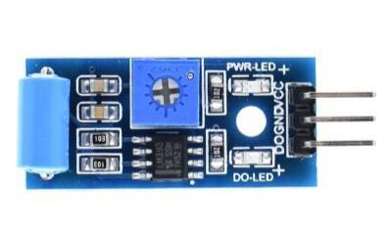
2. Vibration Sensor: Monitors vibrations in machines or environments.
Source :- https://images.app.goo.gl/ndbcN2vJKJwtyNzi6

Slide 20
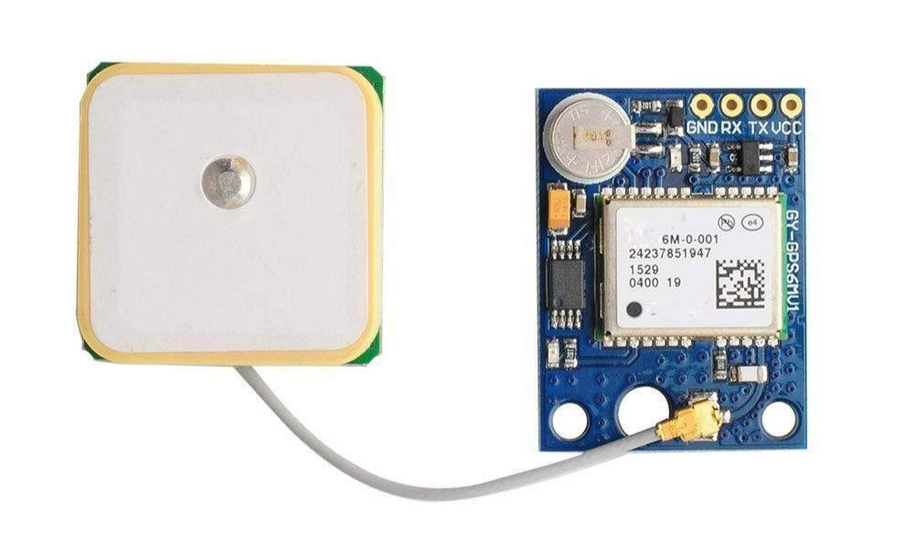
Position and Navigation Sensors
1. GPS Sensor: Tracks location and position.
Source :- https://images.app.goo.gl/8vLF7QWknuGnfCMXA

Slide 21
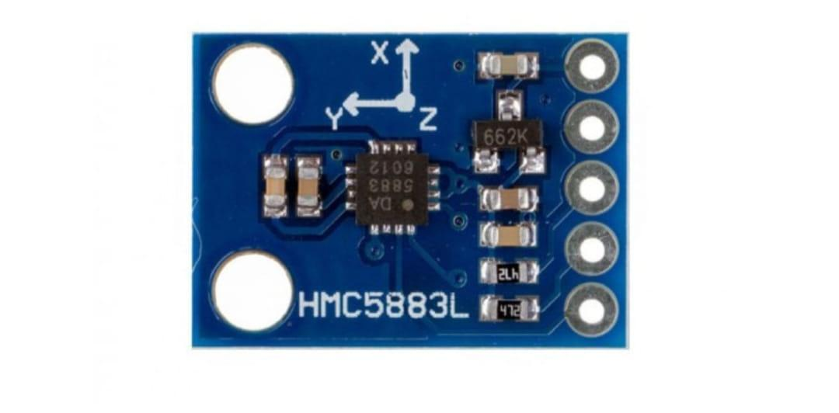
2. Magnetometer: Measures magnetic fields, often used as a compass.
Source :- https://images.app.goo.gl/yNmsbMyBuAkhhEQT6

Slide 22
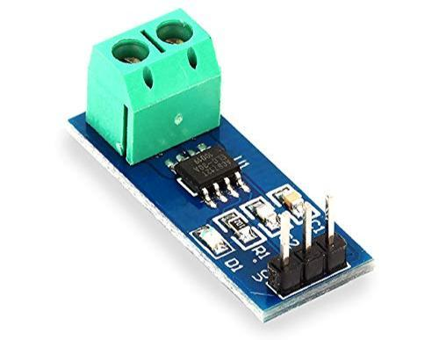
Energy Sensors
Current Sensor: Monitors electric current.
Source:- https://images.app.goo.gl/NbqgAzRqr7SEoymB8

Slide 23
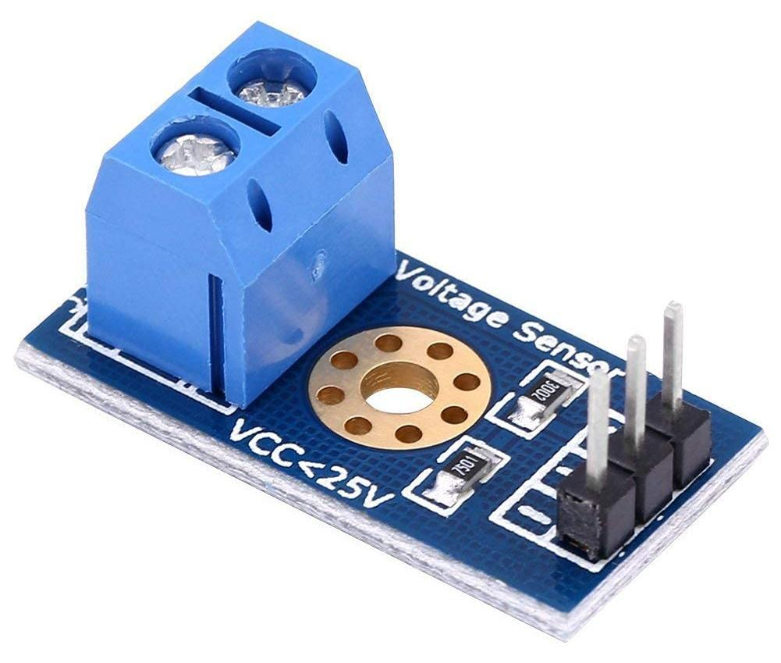
2. Voltage Sensor: Measures voltage levels.
Source :- https://images.app.goo.gl/2Qhe6VN5tHDYUdGGA

Slide 24
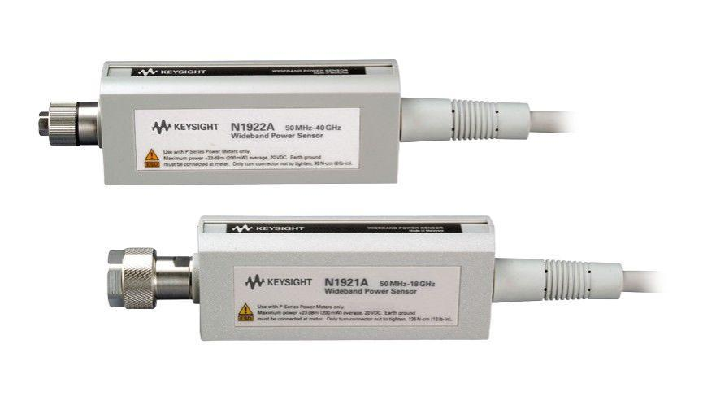
3. Power Sensor: Tracks power consumption.
Source :- https://images.app.goo.gl/YHUUyheJx1nnfu5y7

Slide 25
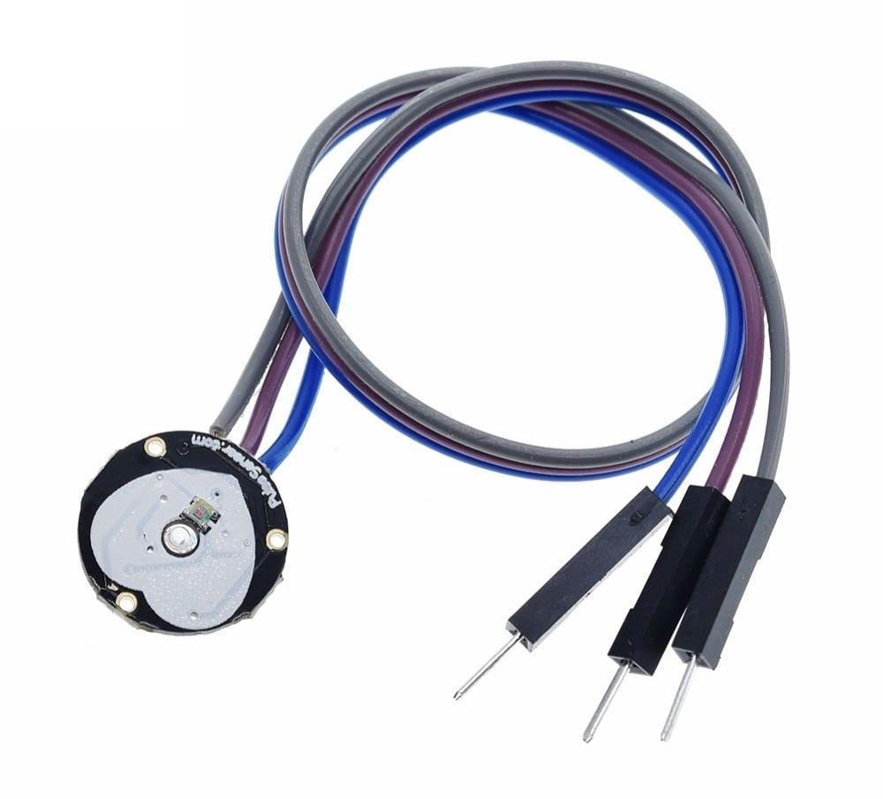
Health and Biometric Sensors
Heart Rate Sensor: Monitors pulse or heart rate.
Source :- https://images.app.goo.gl/N7Ptos2omK6da8mQ6

Slide 26
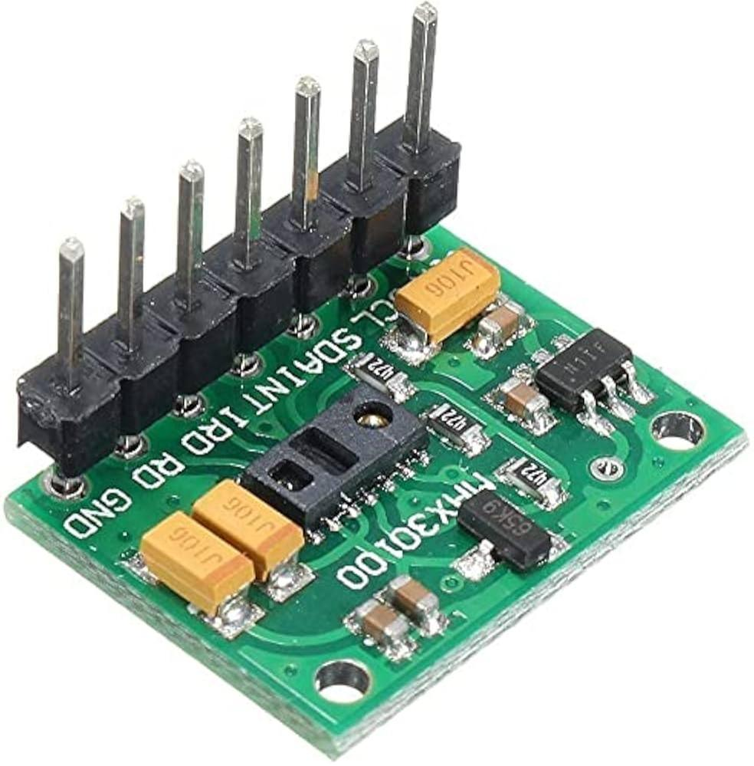
2. SpO2 Sensor: Measures blood oxygen levels.
Source :- https://images.app.goo.gl/QUVF7aH7aaid2hrU9

Slide 27
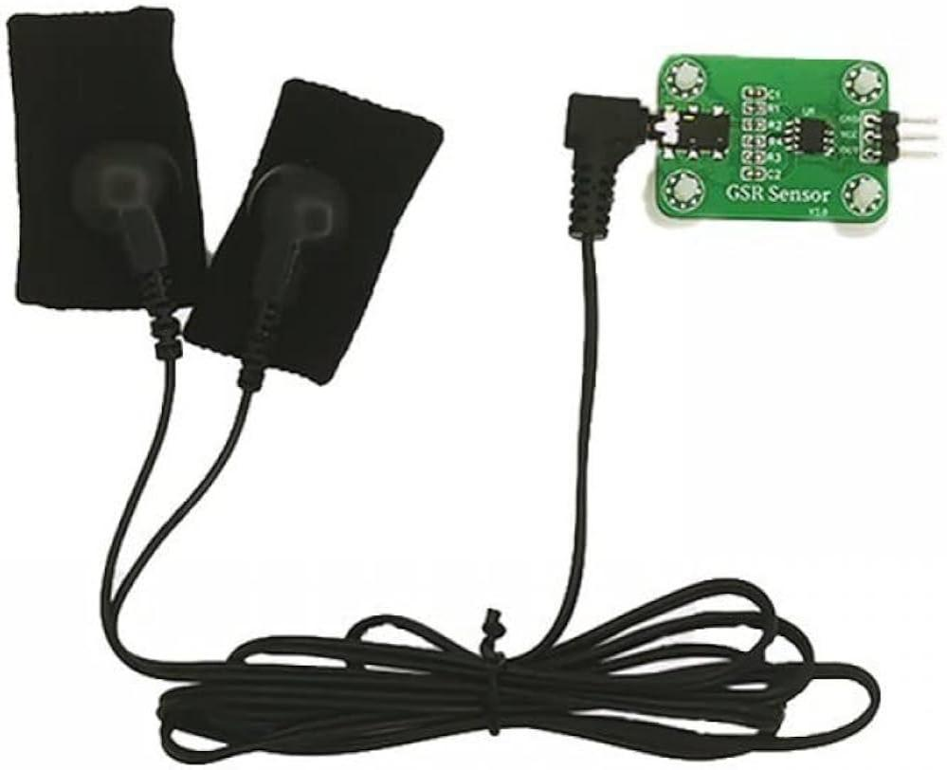
Temperature Skin Sensor: Detects body temperature.
Source :- https://images.app.goo.gl/umaxeDUiW7W4ULTY9

Slide 28
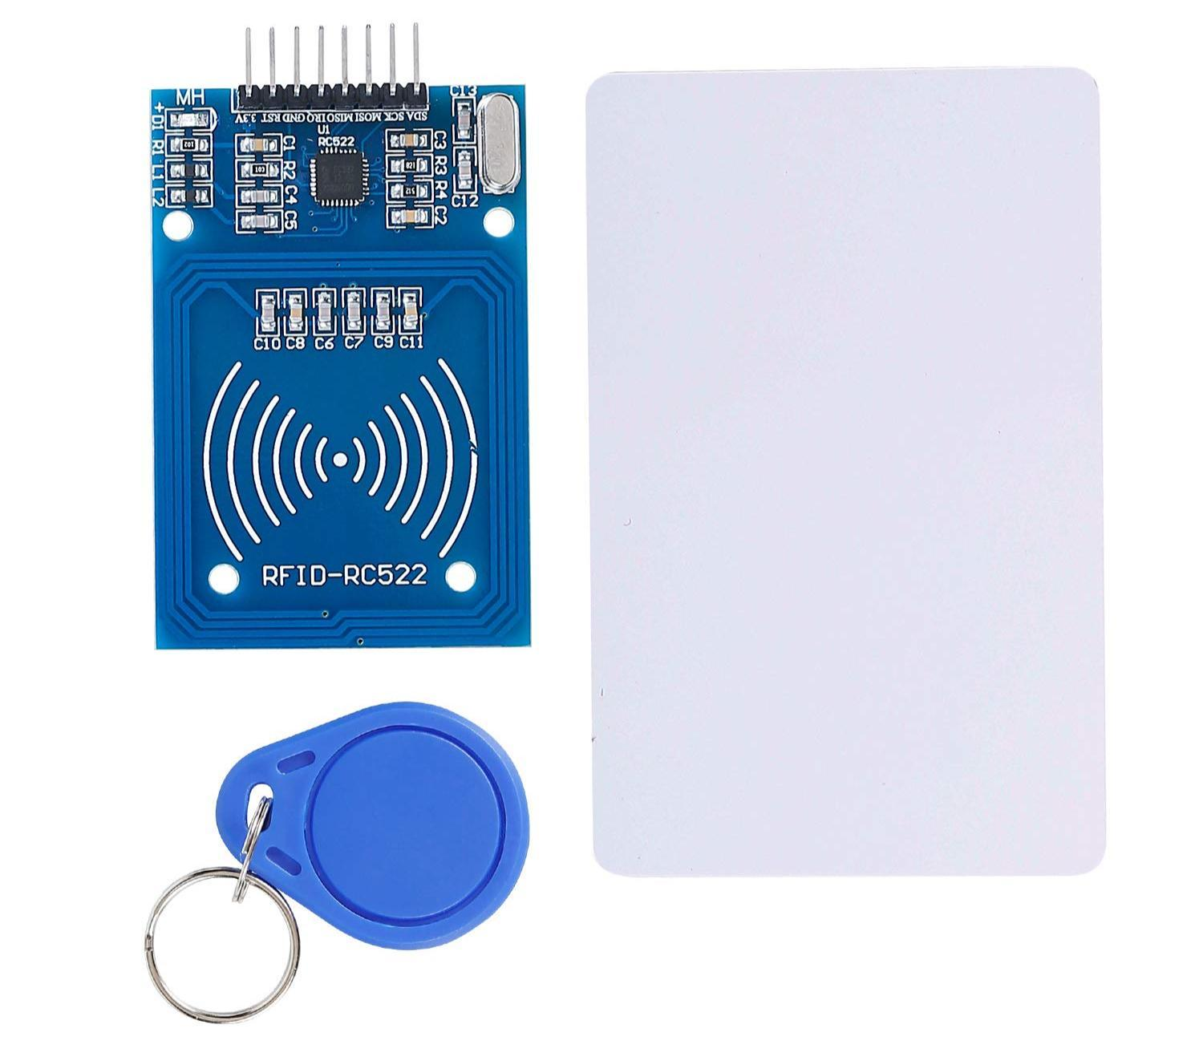
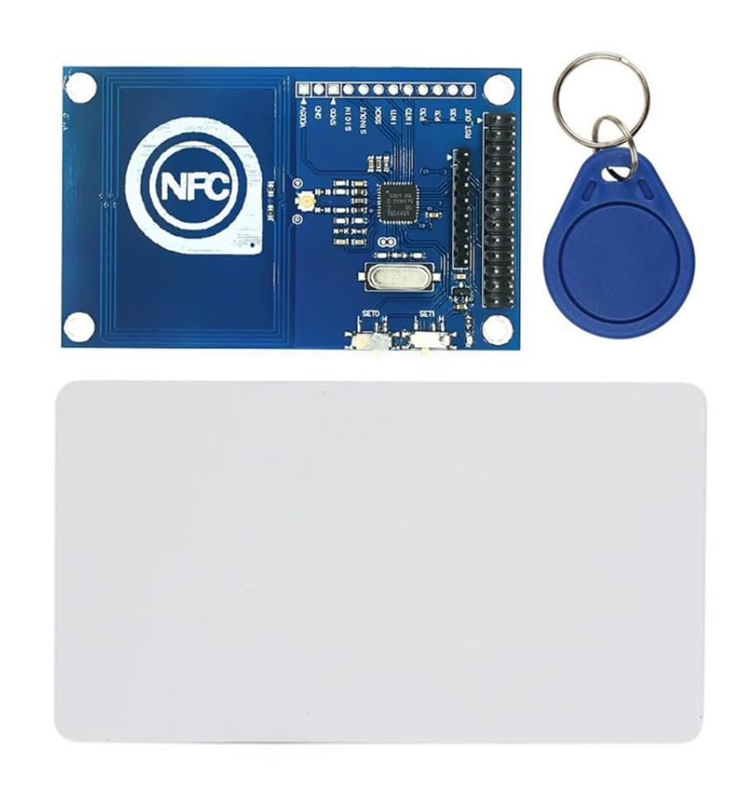
Specialty Sensors
1.RFID/NFC Sensors: Used for object identification and tracking.
Source :- https://images.app.goo.gl/AB4L5VwEqqYsRLjx8
Source :- https://images.app.goo.gl/HJtud2MGNycMrUqS7

Slide 29
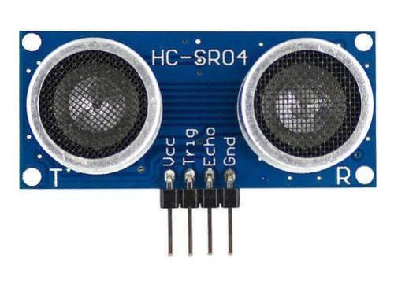
2. Ultrasonic Sensor: Measures distance using ultrasonic waves.
Source :- https://images.app.goo.gl/VUdYPd9bmv691mo46

Slide 30
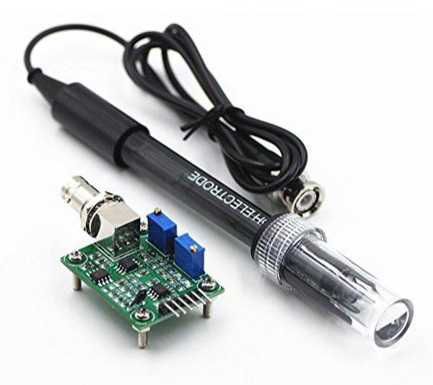
3. pH Sensor: Measures acidity or alkalinity in liquids.
Source :- https://images.app.goo.gl/nue4RDYFSFnn7zC68

Slide 31
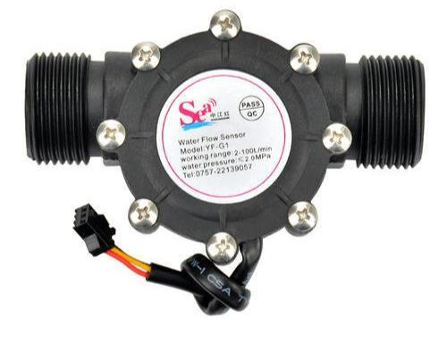
4. Flow Sensor: Monitors liquid or gas flow rates.
Source :- https://images.app.goo.gl/pSBQEZgx6ag718547

Slide 32
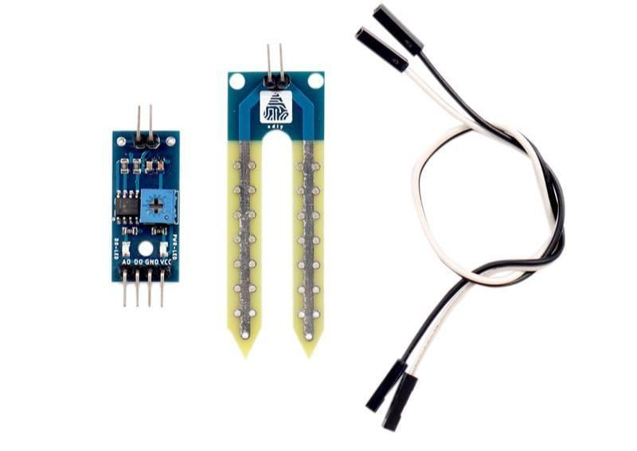
5. Soil Moisture Sensor: Detects water content in soil.
Source :- https://images.app.goo.gl/ywFkGBrm5mRnkSeb8

Slide 33


